Slide 1


AIDA
Banasthali Vidyapith
Prepared by BTI_G19
Aditi Jaiswal(2016699) IT
Avni Jindal(2016728) IT
Deeksha Aggarwal(2016734) IT
Ismit Singh(2016752) IT

Slide 2
Table of contents
❖ Introduction
❖ Problems in already existing portals
❖ Product functions
❖ System Features
❖ Assumptions and Dependencies
❖ User classes and characteristics
❖ Use Case Diagram for admin and user
❖ ER diagram for user and admin
❖ Class Diagram
❖ Activity Diagram
❖ Tables
❖ User interface Design
❖ References

Slide 3

INTRODUCTION
AIDA is a web-based application.
The major goal of "AIDA" is to give customers an easy way to acquire answers to their questions regarding Banasthali Vidyapith University through the website.
It enables quick access to the information required to address one's concerns

Slide 4

Problems in already existing portals
1
It is not understanding the local language of the user.
If there is some spelling mistake or some slang is used it will not give the proper answer.
Complexities in tiny inquiries being addressed.

Slide 5
Product Functions
Guest Access
Access information about Banasthali Vidyapith such as:
1.Courses 2.Admission
3.Fees
4.Campus
Student Login and Interaction
1. Student Login
2. Validate Student Account
3. Connect with AIDA
4. Queries Request and Response
Admin functionalities
1. Insert Data
2. Delete Data
3.Modify Data

Slide 6
Product Functions
Authorized (Student) User functionalities
Access data related to university
Database module:
Stores the email id and passwords of student
Authentication Module:
Allow the user to log in using a password

Slide 7
System Features
Hardware Interfaces
Client-Side Requirements:
Server-Side Requirements:
✔ RAM: Min 4 GB
✔ HDD: 20 GB or more (Free space excluding data size)
✔ Processor: Min 3
GHz or onwards
Client-Side Requirements:
✔ RAM: Min 512 MB
✔ HDD: 10 GB or more (Free space excluding data size)
✔ Processor: Min 1 GHz or onwards.

Slide 8
Software Interfaces
TECHNOLOGY | SOFTWARE PRODUCT
Client Server | Web Browser
OS | Windows
Database Server | MySQL
Development End | HTML, JavaScript, CSS, NodeJS
API | Dialogflow

Slide 9
Assumptions and Dependencies
It is assumed that:
➢ users can read and write in English.
➢ Users have devices that support internet service.
➢ Users are familiar with internet browsing and can interact with a web application.
➢ Users have a decent internet connection.
The final output depends on:
➢ The Accuracy of the different APIs and AI/ML tools(Dialog Flow).
➢ Efficiency and Security of the Databases
➢ Wi-Fi access
➢ Devices used

Slide 10
User Classes and Charachterstics
ADMIN
Admin is responsible for maintaining, updating the database, and viewing the results of the feedback. They can update databases and are responsible for the maintenance of web applications.
USER
The ability to use the interface for creating and viewing solutions is a technological need. To save the chosen queries, the user needs to be logged in. Users are welcome to utilise any other features as a guest.

Slide 11
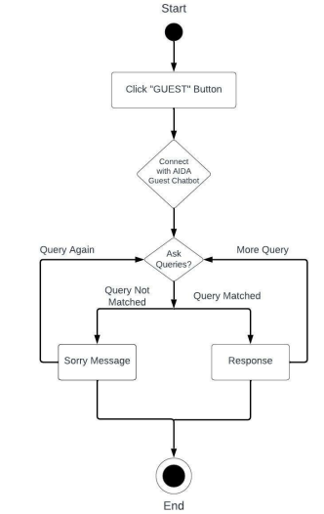
Big concept
Activity Diagram
Guest Access

Slide 12
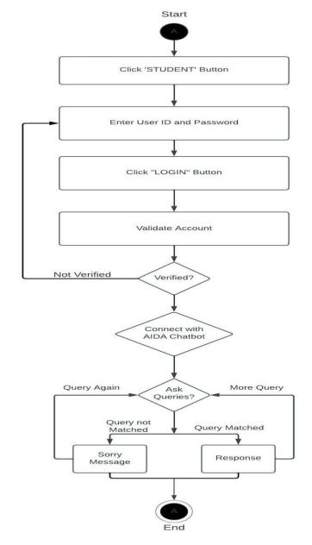
Big concept
STUDENT Login and Interaction

Slide 13
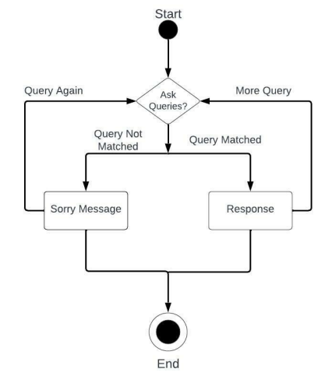
Big concept
GUEST User functionalities

Slide 14
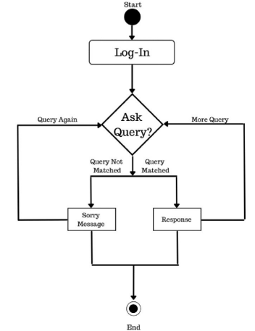
Big concept
Authorized (Student) User functionalities

Slide 15
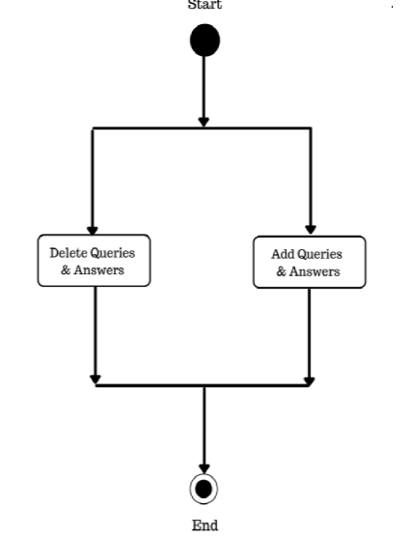
Big concept
Admin functionalities

Slide 16
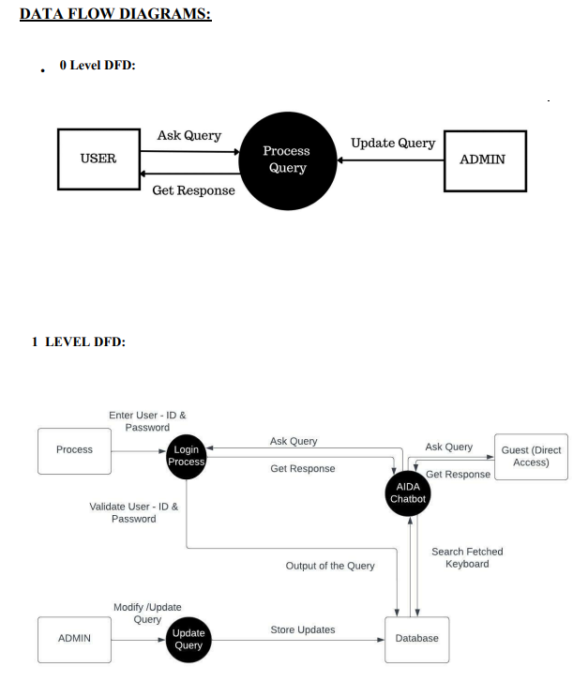
Big concept

Slide 17
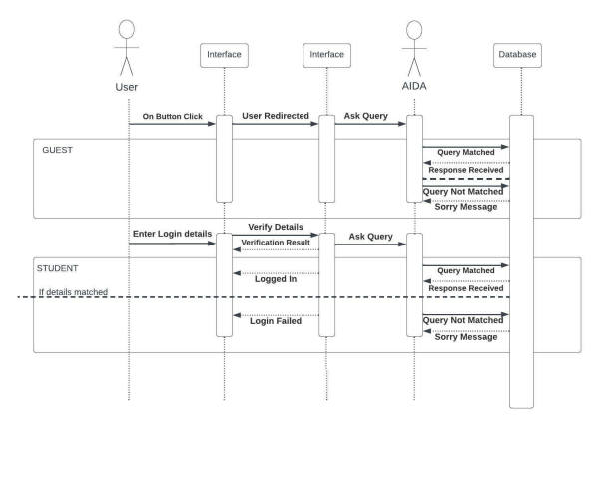
Big concept
SEQUENCE DIAGRAM FOR LOGIN AND QUERY:

Slide 18
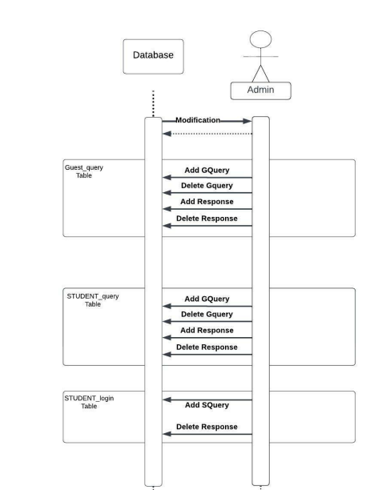
SEQUENCE DIAGRAM FOR ADMIN:

Slide 19
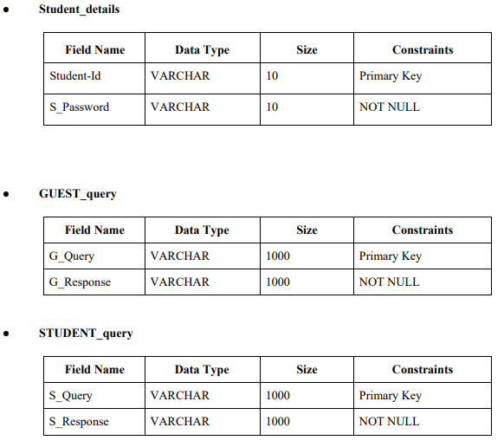
Big concept
Detailed description of component
DATA DICTIONARY

Slide 20
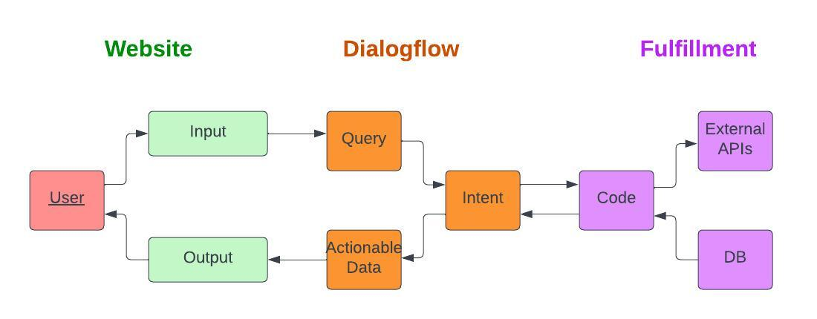
Architecture of Chatbot

Slide 21
The general idea of working of proposed system algorithm is given as follow:
Step 1: Start Step
Step 2: Read Query Step
Step 3: Searches Query in database
Step 4: if keyword = Keyword in database return(response) goto step 5 else return (“Sorry Message”)
Step 5: Give Response for the query then goto step 6
Step 6: If want to ask more/another query goto step 2 else goto step7
Step 7: Stop.

Slide 22
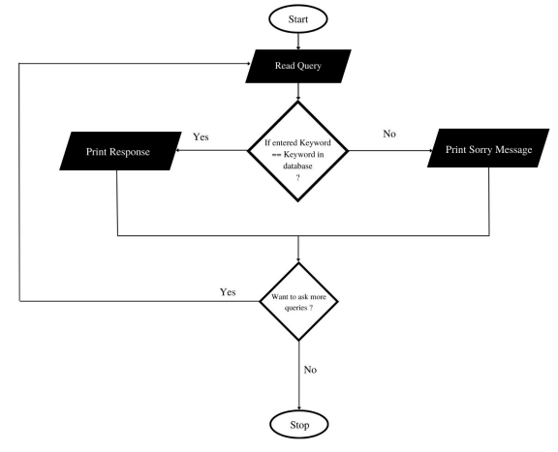
Big concept
The flowchart for above algorithm can be described as follows:

Slide 23

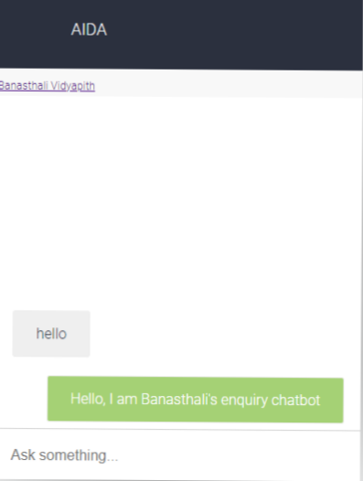
Interface Design (Prototype)

Slide 24
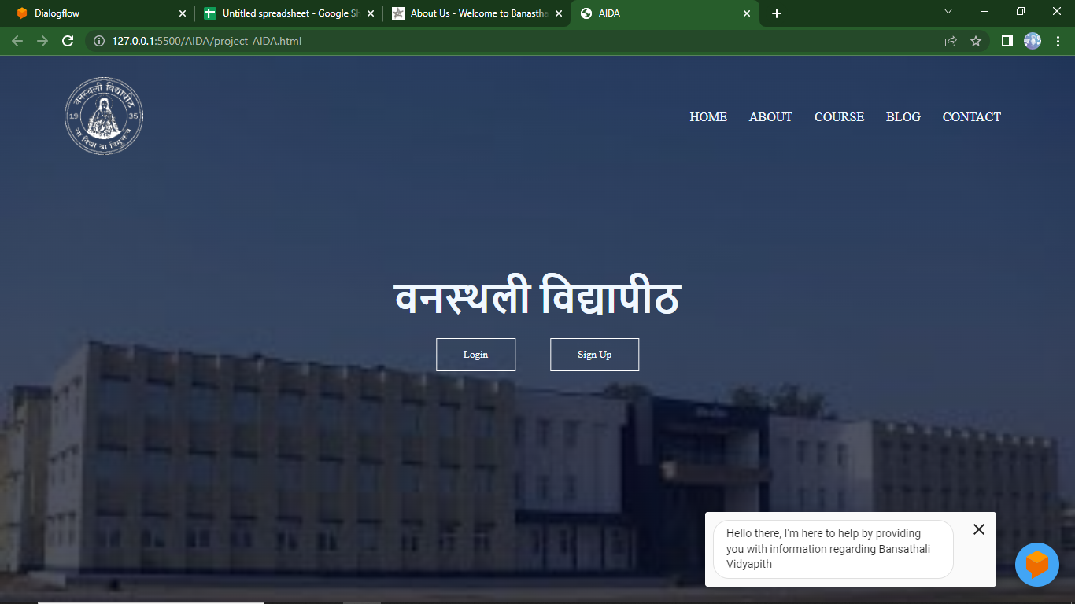

Mobile project
Show and explain your web, app or software projects using these gadget templates.

Slide 25
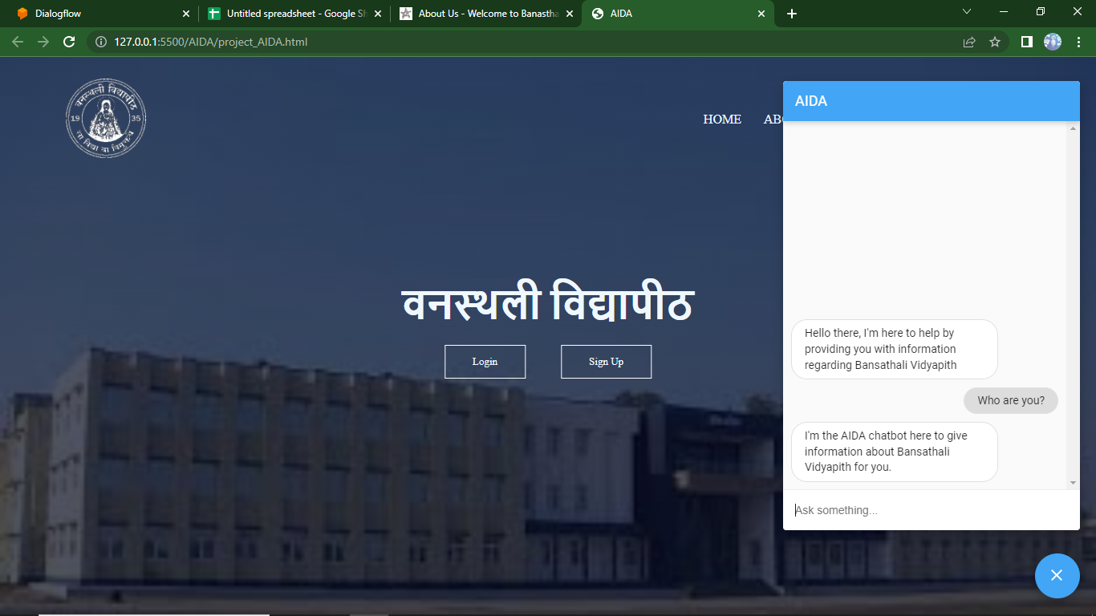
Mobile project
Show and explain your web, app or software projects using these gadget templates.

Slide 26
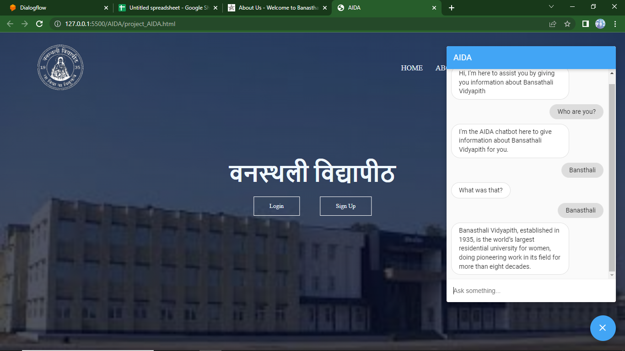
Mobile project
Show and explain your web, app or software projects using these gadget templates.

Slide 27
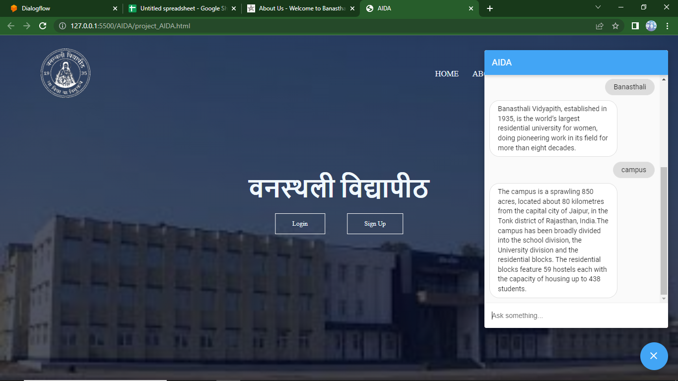
Mobile project
Show and explain your web, app or software projects using these gadget templates.

Slide 28

Thanks!
AIDA CHATBOT

